Slide 1

A San Francisco Crime Map: What story does Crime in San Francisco tell us over the course of a year?
Team Members : Group 4: Chandler, Daniel, Elena, Joe O., Jorge, Nell

Slide 2

Why this topic you ask?
Data availability
San Francisco is a popular place
Curiosity
Will a certain part of town be "safer" than another?
Found an opportunity to create dynamic maps with the data we found
Large Data = Fun fun
Jorge used to work here.

Slide 3
Questions we want answers to??
How does crime look on the different days of the week?
What does it look like by month?
Which part of San Francisco has the most crime versus least?
Pick a street or intersection and drill down to view types of crime in that area.

Slide 4
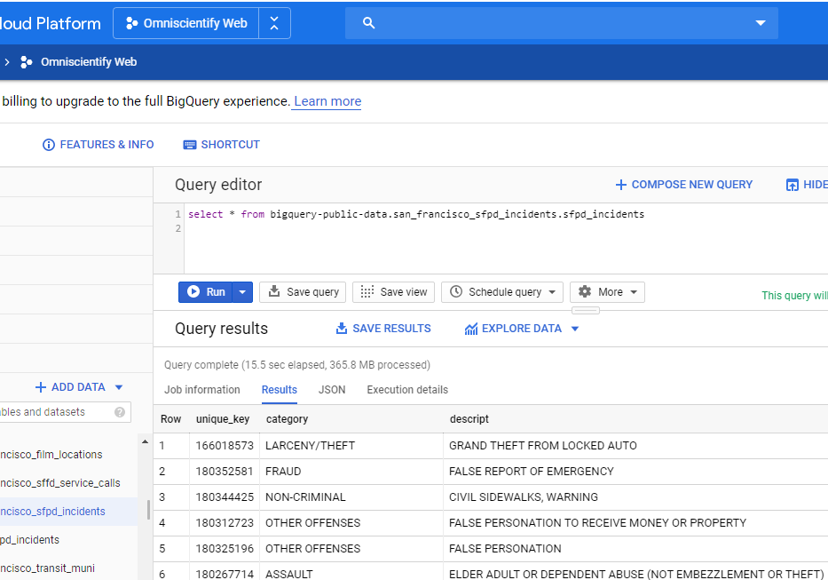
Data used:
Google Cloud BigQuery Public Data
Dataset ID: bigquery-public-data:san_francisco_sfpd_incidents
Data Set(s) Link and Screenshots of Metadata.
Link: https://console.cloud.google.com/bigquery?project=omniscientify-web&folder=&organizationId=&p=bigquery-public-data&d=san_francisco_sfpd_incidents&page=dataset

Slide 5
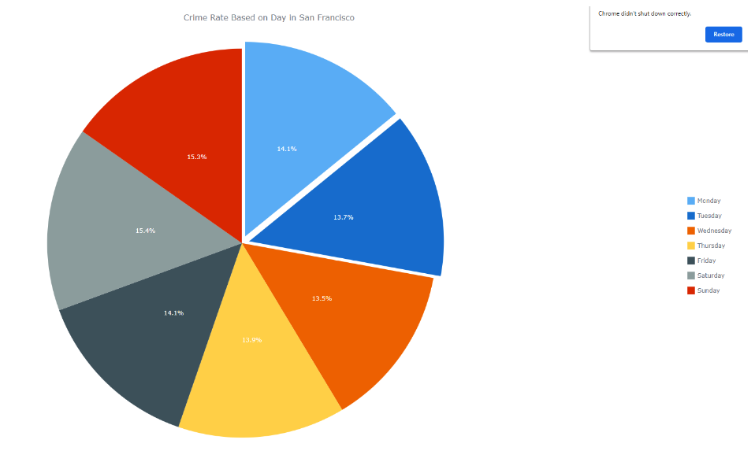
Crime percentage by day of the week
Mon: 14.1%
Tues: 13.7%
Wed: 13.5%
Thurs: 13.9%
Fri: 14.1%
Sat: 15.4%
Sun: 15.3%

Slide 6
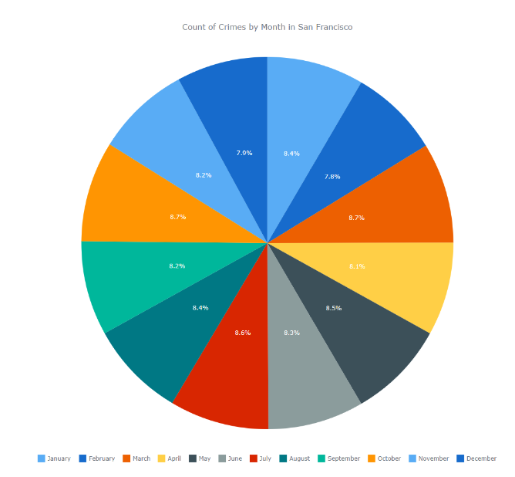
Crime percentage by day of the month
Jan: 8.4%
Feb: 7.8%
Mar: 8.7%
Apr: 8.1%
May: 8.5%
Jun: 8.3%
Jul: 8.6%
Aug: 8.4%
Sept: 8.2%
Oct: 8.7%
Nov: 8.2%
Dec: 7.9%
January value: 8957
February value: 8297
March value: 9286
April value: 8599
May value: 9047
June value: 8862
July value: 9178
August value: 8924
September value: 8722
October value: 9294
November value: 8702
December value: 8410

Slide 7
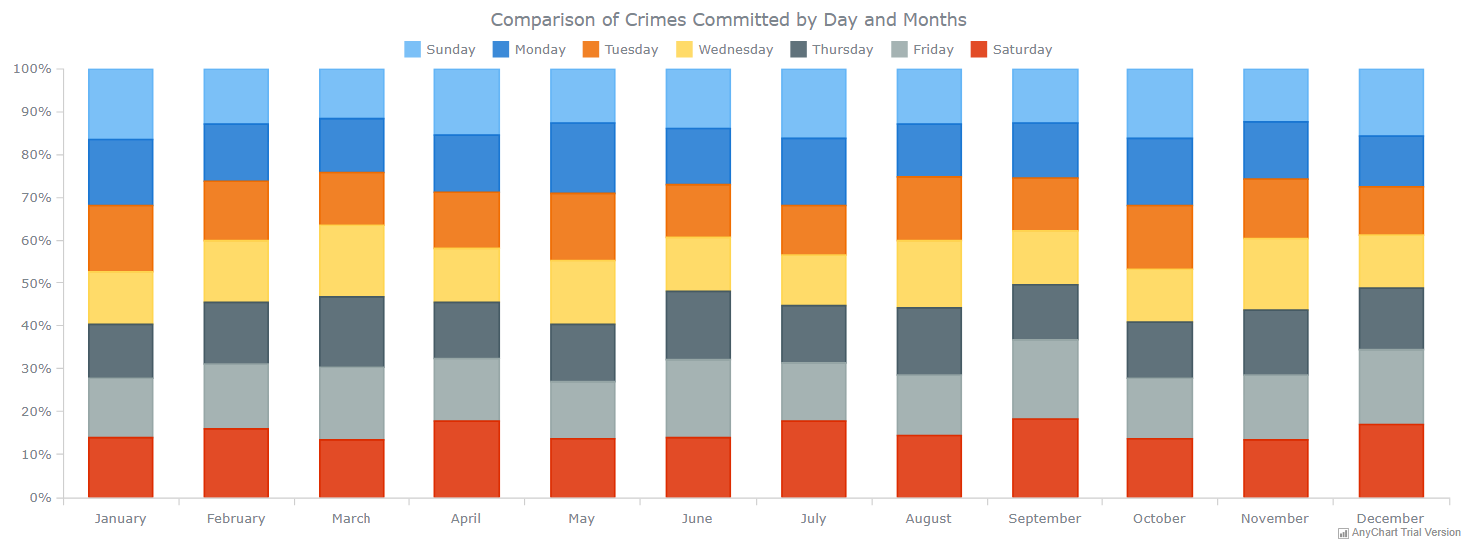
Crimes committed per day of the week, by month

Slide 8
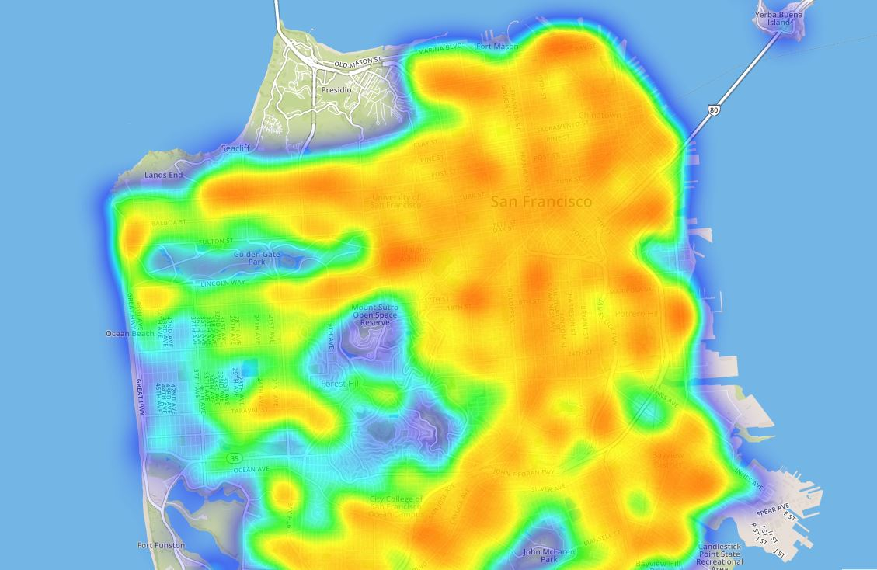
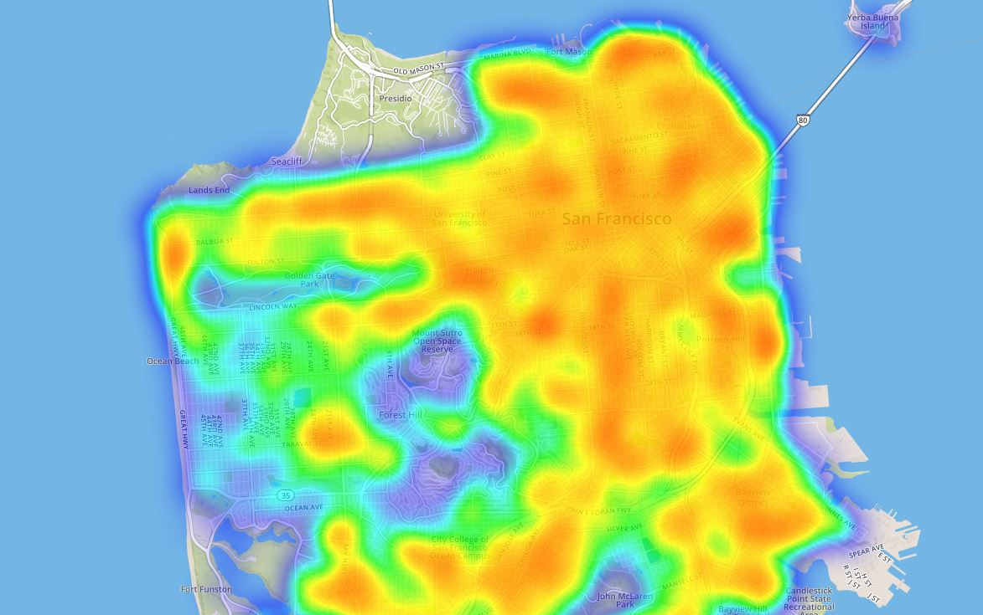
Heat Map of the First 6 months vs the Last 6 months
First 6 Months : 53,048 cases
Last 6 months: 53,830‬ cases

Slide 9
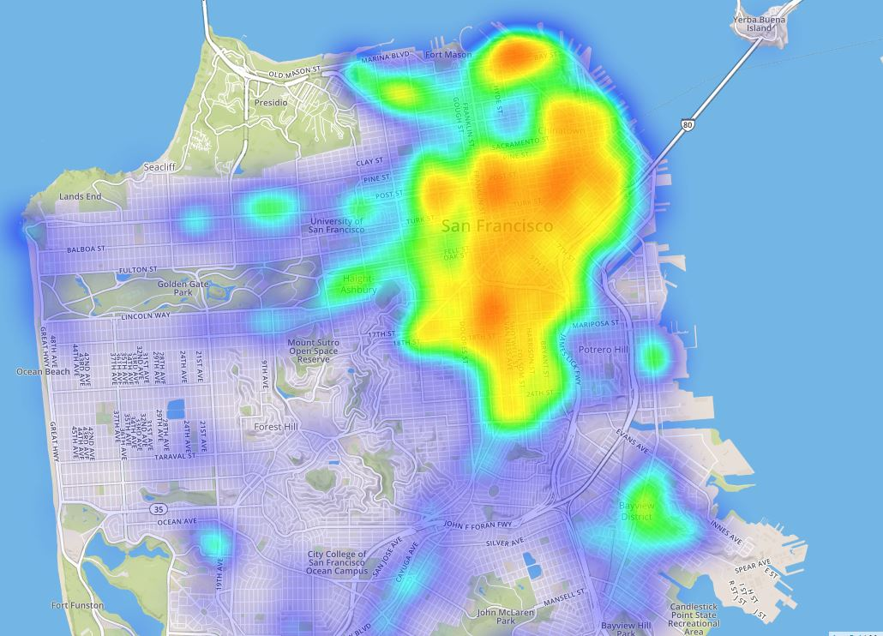
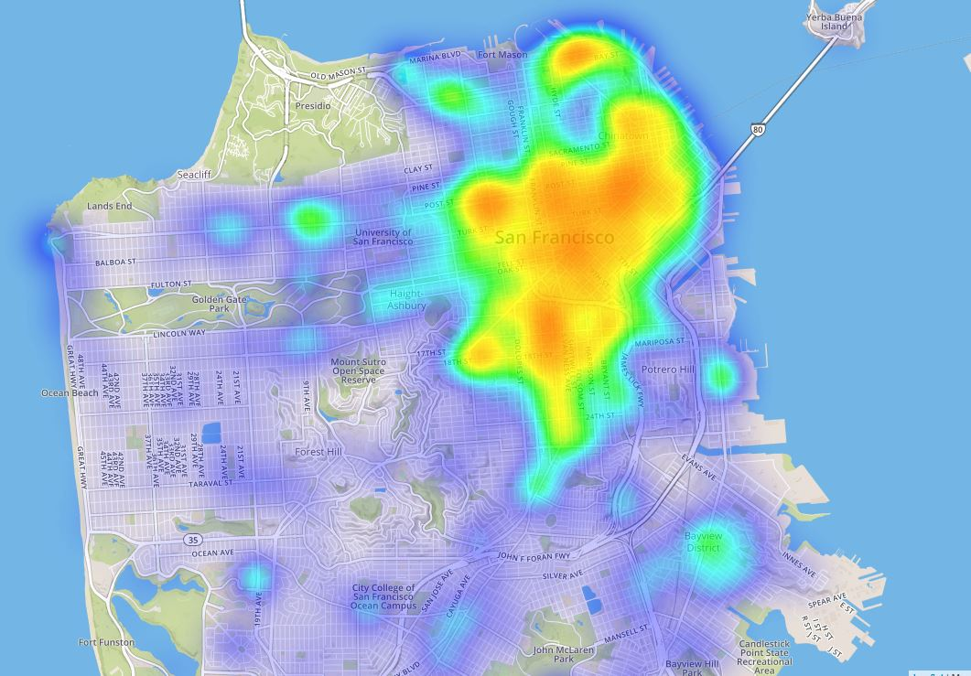
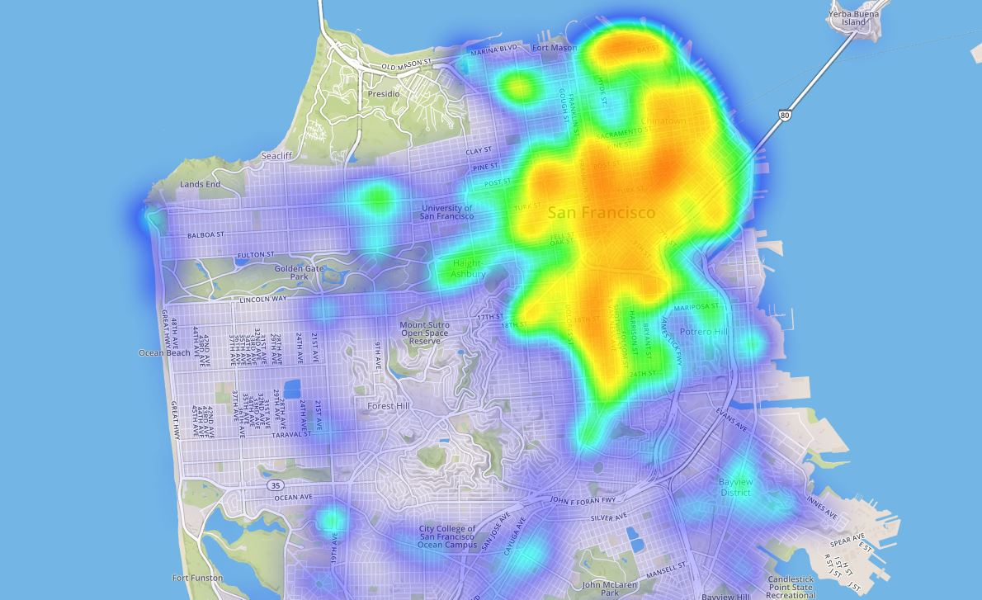
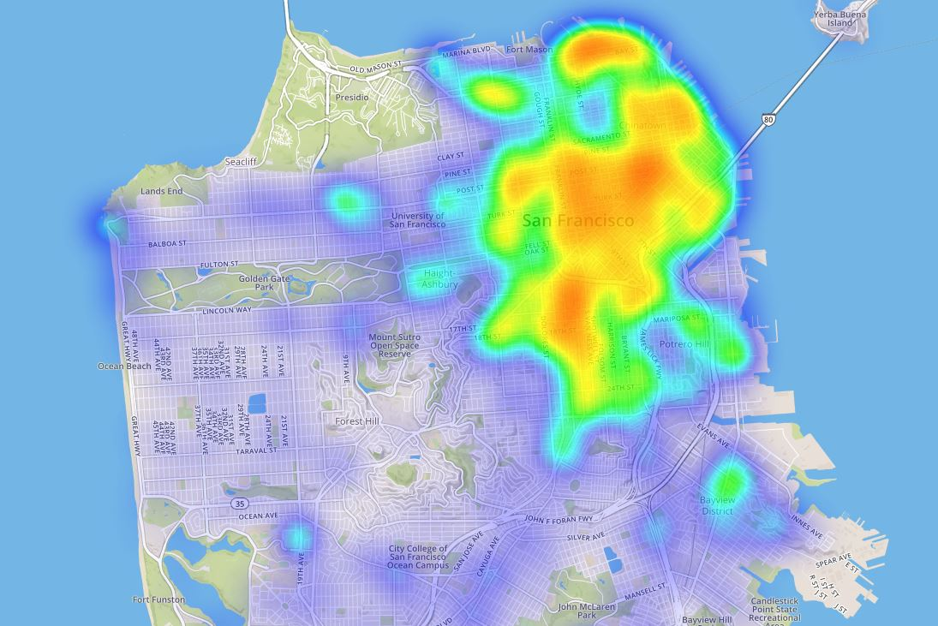
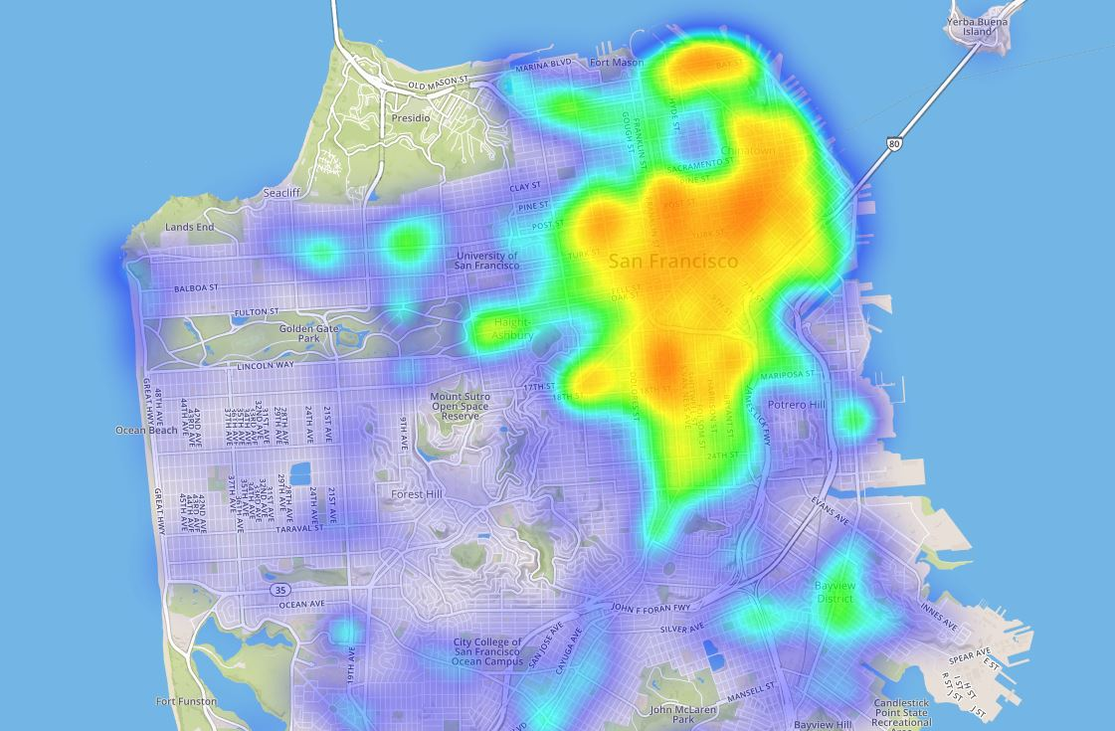
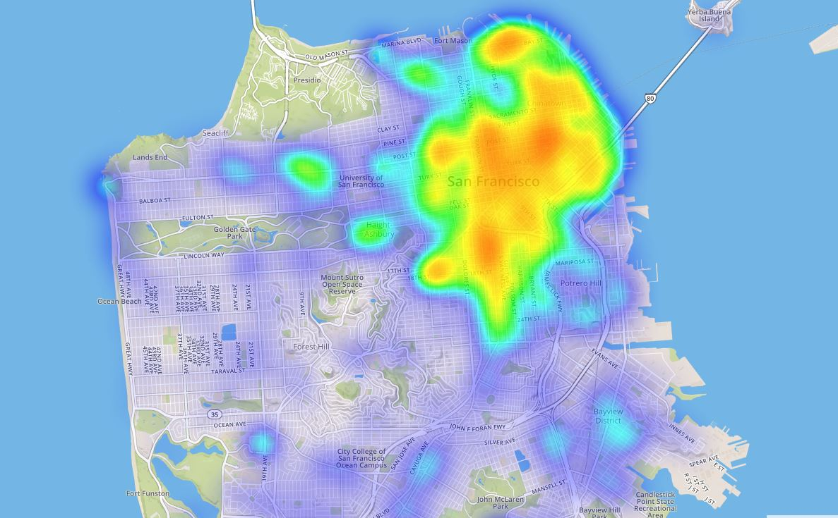
Heat Map of the First 3 months vs the Last 3 months
First 3 months
Last 3 months

Slide 10

Conclusion
Day with the highest crime rate:
Saturday
Month with the highest Crime rate:
October value: 9294
Heat map:
Similarities between the different time frame
Areas where they were hot vs not throughout the year
Highest Crime
Larceny and Theft
Total categories: 39

Slide 11

What were the issues?
Issues with JavaScript with loading heatmaps and marker clusters groups in one layer
"Camir"
Large data set had similarities in our results across dimensions
Over 2,000,000 record, we used 1 year which is about 100,000 records
Connecting the flask app to the webpage project due to the size of the data
Would have made a very crowded heat map and charts
Managing data types

Slide 12
Wanna check out the page?
Click here

